Slide 1
UCB
Project 1

Slide 2
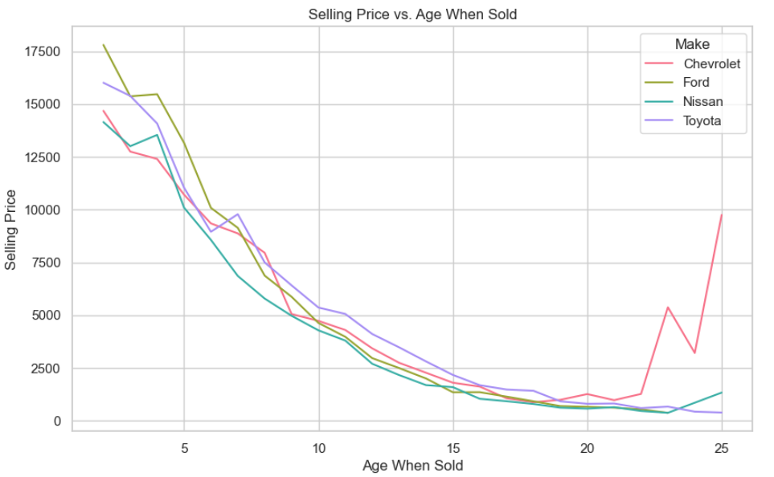
Dollar Depreciation: automobile age versus $ price (only four makes)
There is little difference in depreciation by car make
The spike in costs for Chevy’s seems to be driven by only a few cars (see next page)

Slide 3
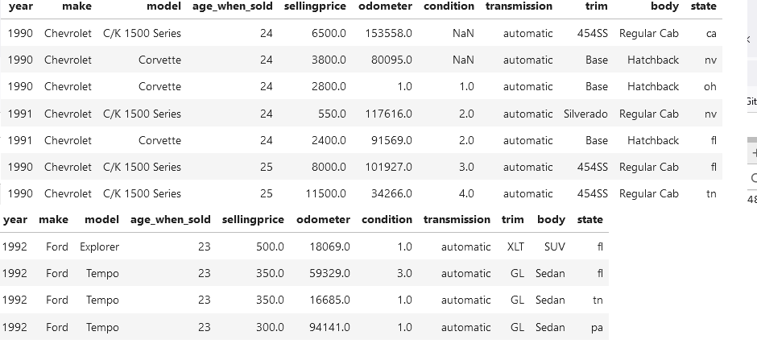
Older Model Chevy and Fords

Slide 4
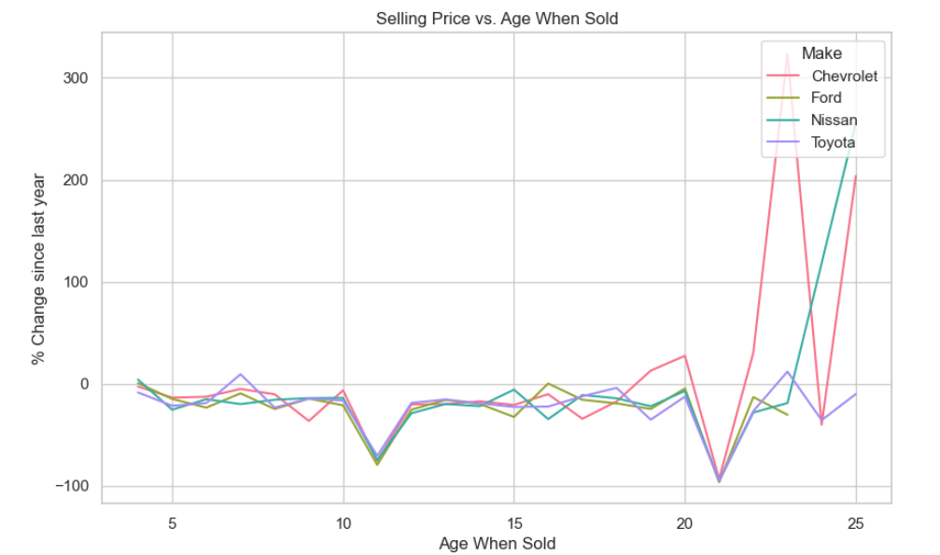
Dollar Depreciation: automobile age versus % change previous year (only four makes)
Similar to last graph
Large drop in car sales

Slide 5
About car_prices.csv
The "Vehicle Sales and Market Trends Dataset" provides a comprehensive collection of information pertaining to the sales transactions of various vehicles. This dataset encompasses details such as the year, make, model, trim, body type, transmission type, VIN (Vehicle Identification Number), state of registration, condition rating, odometer reading, exterior and interior colors, seller information, Manheim Market Report (MMR) values, selling prices, and sale dates.

Slide 6
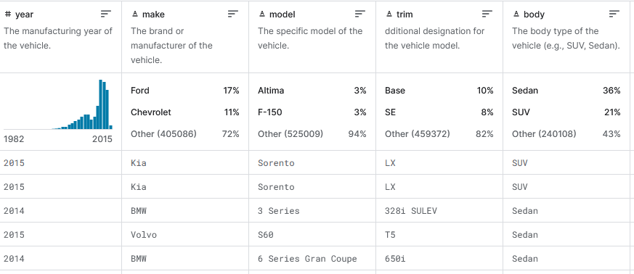

Slide 7
